Slide 1

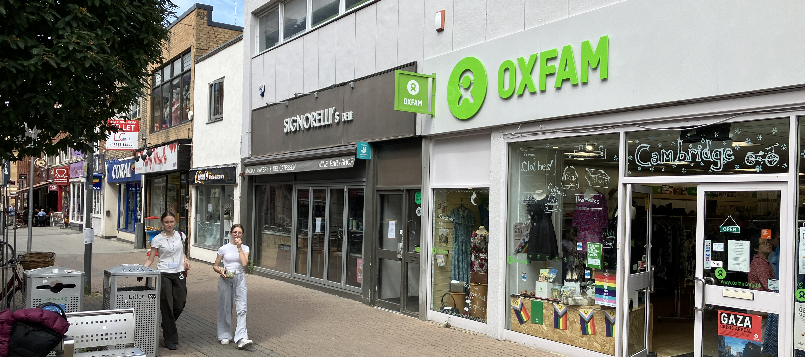
CAMBRIDGE
17 Burleigh Street, Cambridge CB1 1DG
PRIME RETAIL UNIT- TO LET
LOCATION
Cambridge is an affluent city and considered one of the most in the UK. The Cambridge catchment contains 910,000 residents and 284,000 shoppers and is affluent with 44% being ranked in two of the most affluent ACORN profiles – 39% above UK average. Cambridge has a large student population attracting over 30k students, along 17 million visitors each year.
Burleigh Street is located West of the main entrance to the Grafton Centre, and is a 10 minute walk from the city centre. The Grafton centre is in the process of being repurposed into life sciences.
The property occupies a prominent position on Burleigh Street opposite Primark and Sharps and adjacent to Oxfam.
ACCOMMODATION
The property provides the following approximate areas;
Ground Floor: 1,536 sq ft 142.7 sq m
LEASE TERM
A new effectively full repairing and insuring lease for a term to be agreed.
RENTAL
£45,000 pa
SERVICE CHARGE
£230 pa To be confirmed.
RATING
The property is assessed for rates as follows:
Rateable Value 2023: £34,000 pa
UBR 2025/26: 49.9p
Estimated Rates Payable: £16,960 pa
This information is for guidance purposes only. Interested parties are advised to make their own enquiries with the VOA.
From April 2026, the revised rateable value for this property is £36,750.
EPC
Available on request.
LEGAL COSTS
Each party shall be responsible for their own legal costs incurred in this transaction.
VIEWING AND FURTHER INFORMATION
All viewings should be made strictly via appointment.
Filippa Mudd
07917 034807
filippamudd@fmx.co.uk
Or via our joint agent, Bidwells.
Date: January 2026
FMX for themselves and for the vendors or lessors of this property whose agents they are give notices that: (i) The particulars are set out as a general outline only for the guidance of intending purchasers or lessees, and do not constitute, nor constitute part of, an offer or contract; (ii) All descriptions, dimensions, references to condition and necessary permission for the use and occupation, and other details are given in good faith and are believed to be correct, but intending purchasers or tenants should not rely on them as statements or representations of fact, but must satisfy themselves by inspection or otherwise as to the correctness of each of them; (iii) No person in the employment of MMX Retail has any authority to make or give any representation or warranty whatsoever in relation to this property.
4th Floor, 41-43 Maddox Street, London, W1S 2PD
www.fmx.co.uk

Slide 2
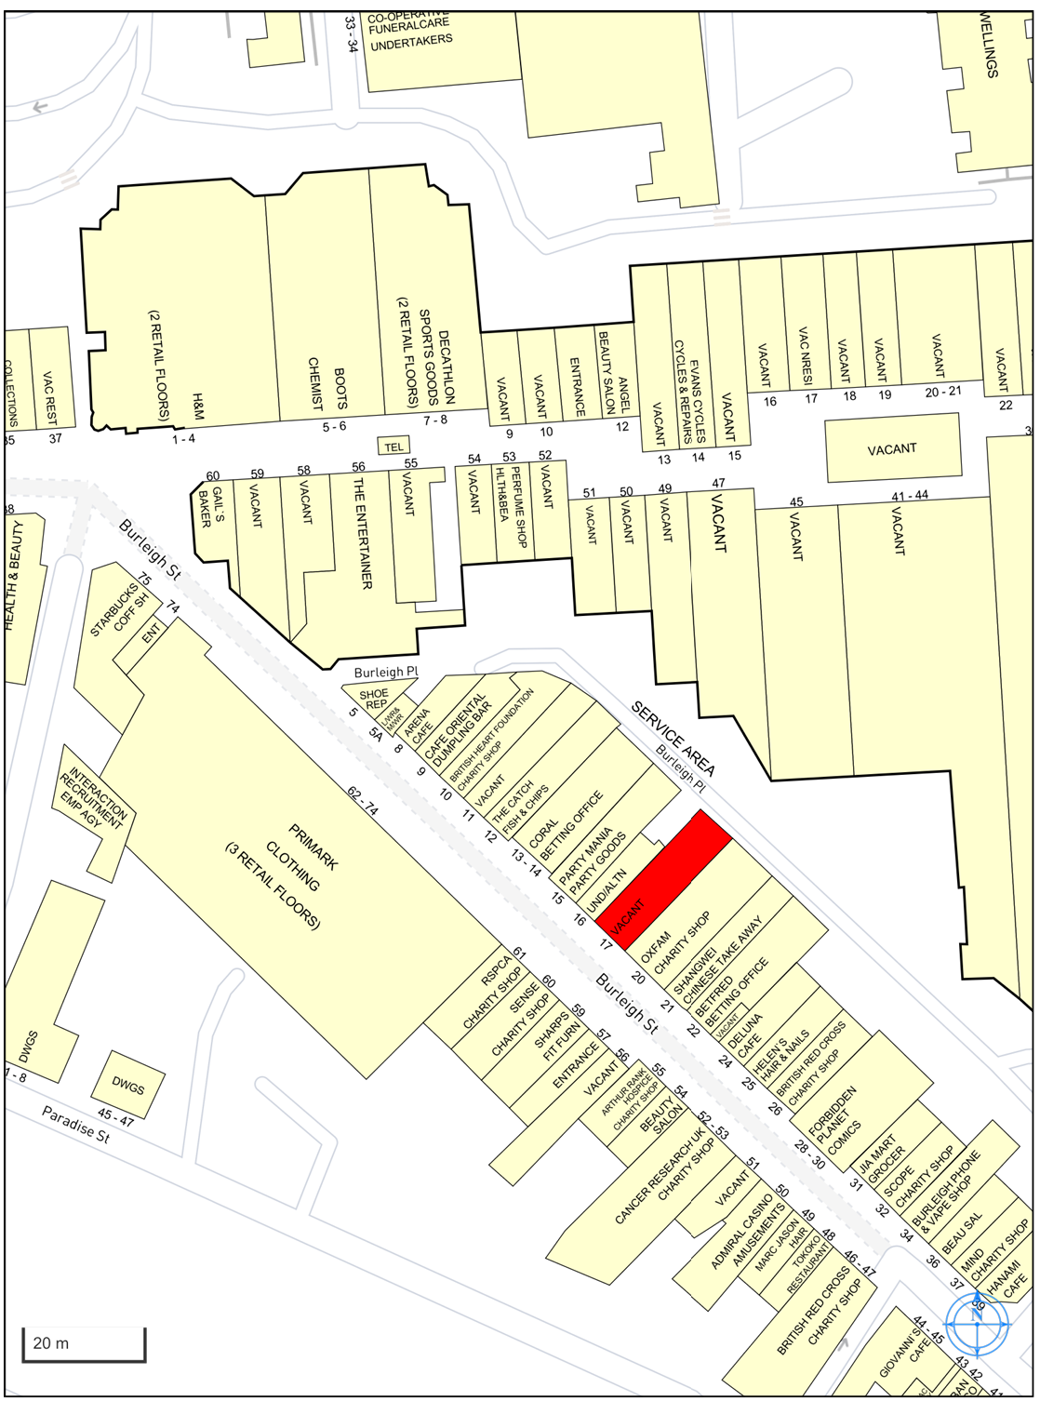
FMX for themselves and for the vendors or lessors of this property whose agents they are give notices that: (i) The particulars are set out as a general outline only for the guidance of intending purchasers or lessees, and do not constitute, nor constitute part of, an offer or contract; (ii) All descriptions, dimensions, references to condition and necessary permission for the use and occupation, and other details are given in good faith and are believed to be correct, but intending purchasers or tenants should not rely on them as statements or representations of fact, but must satisfy themselves by inspection or otherwise as to the correctness of each of them; (iii) No person in the employment of MMX Retail has any authority to make or give any representation or warranty whatsoever in relation to this property.
4th Floor, 41-43 Maddox Street, London, W1S 2PD
www.fmx.co.uk

